Slide 1
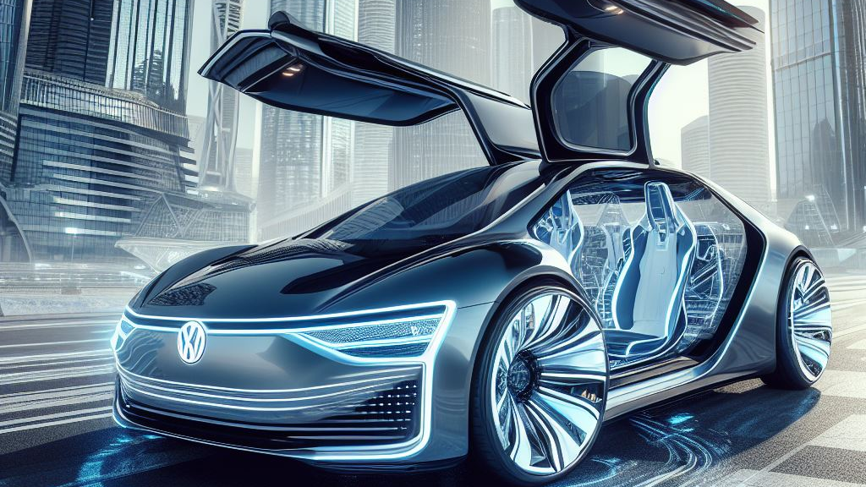
Volkswagen Unleashes the Future
Tailored Car Designs with Generative AI!

Slide 2
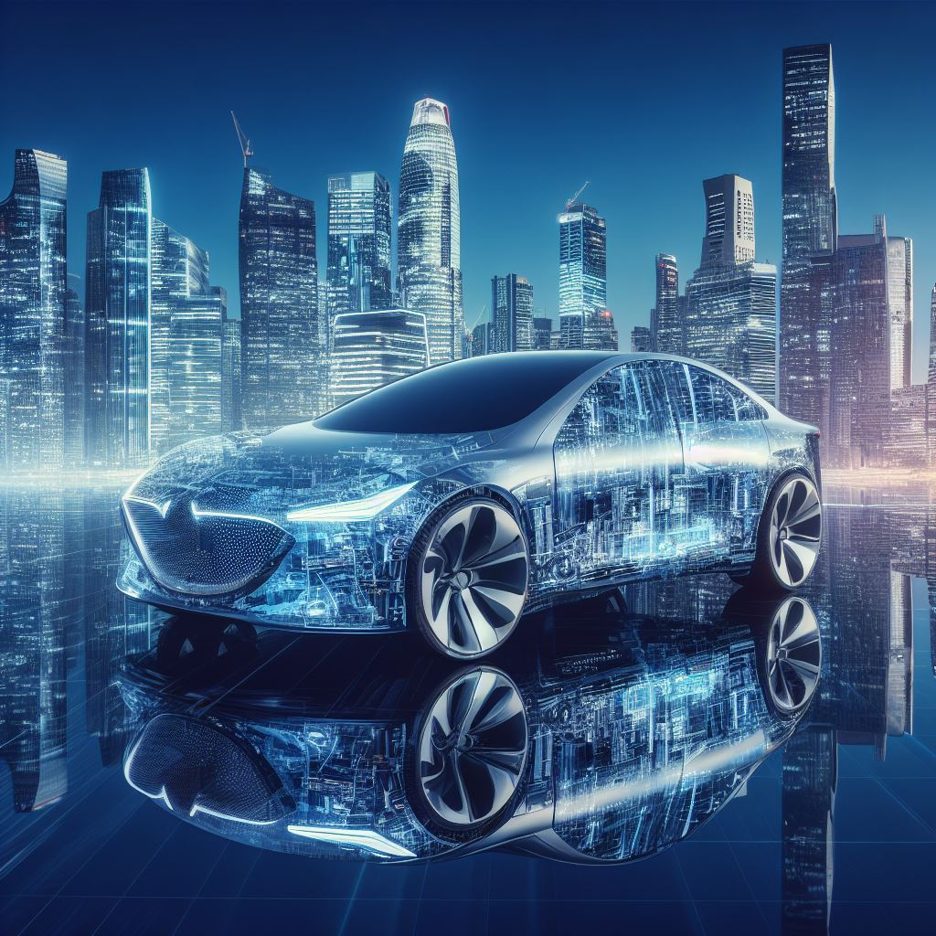
Introduction
In today's automotive landscape, the power of personalization cannot be overstated. Consumers now seek vehicles that are as unique as they are, demanding designs that resonate with their individual tastes and preferences.
Traditional design methods, though effective in their own right, face inherent limitations. They often struggle to capture the intricate nuances of each customer's vision, leading to a potential disconnect between what is envisioned and what is delivered

Slide 3
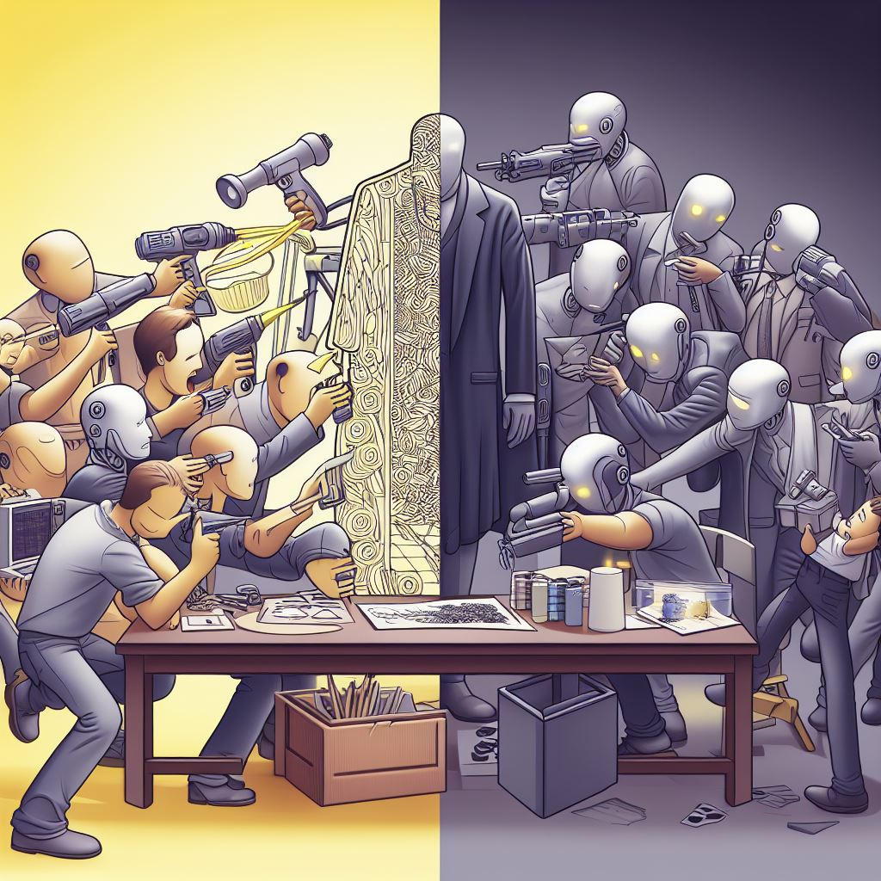
Problem Statement
Traditional design methods, though proven, struggle with a critical challenge in today's automotive landscape. They often fall short in capturing the intricacies of individual preferences, prioritizing broad appeal.
Unaddressed, this gap could have significant ramifications for Volkswagen. In a personalized market, failure to meet bespoke needs may lead to a potential loss of market share and missing out on a premium segment.

Slide 4
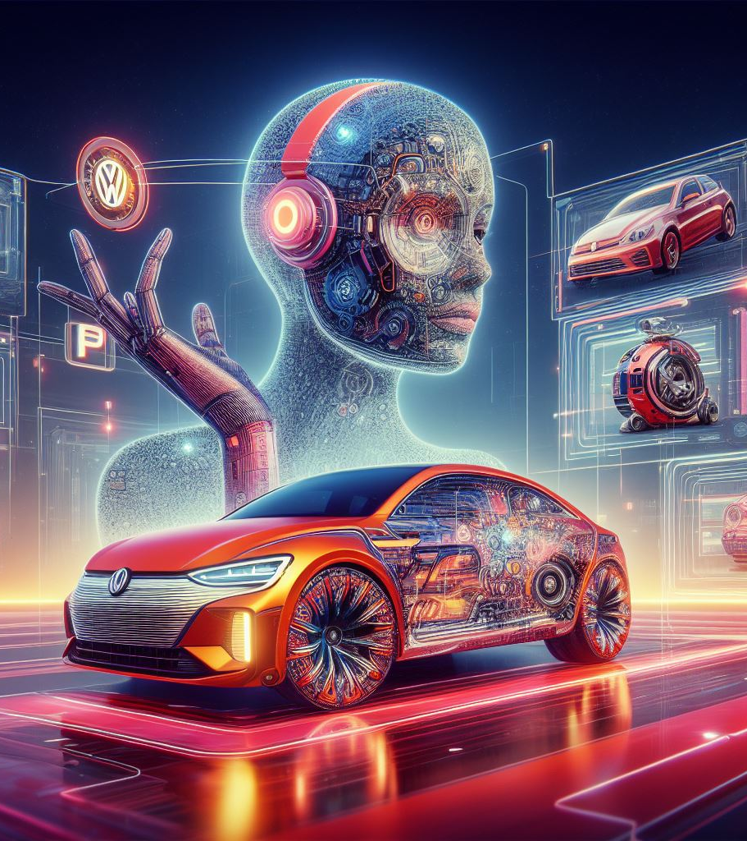
Solution Overview
Our innovative solution harnesses Generative AI to craft personalized car designs, tailored to individual preferences. This approach revolutionizes traditional design methods, ensuring each design is not only aesthetically pleasing but also functional and aligned with Volkswagen's brand standards.

Slide 5
How It Works
Customer input (questionnaire/visual feedback)
AI-driven design generation
Customer feedback loop for iterations

Slide 6
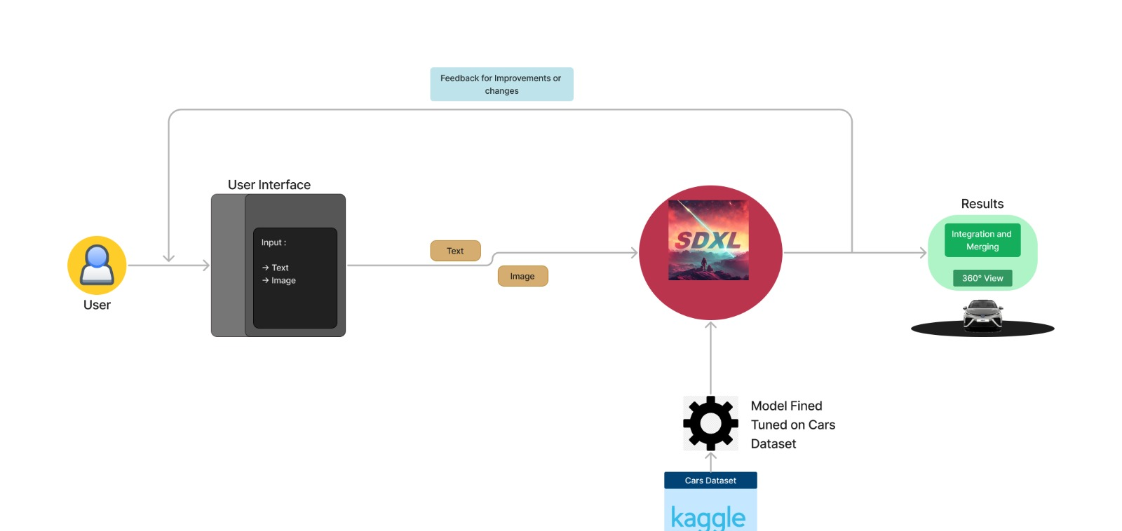

Slide 7
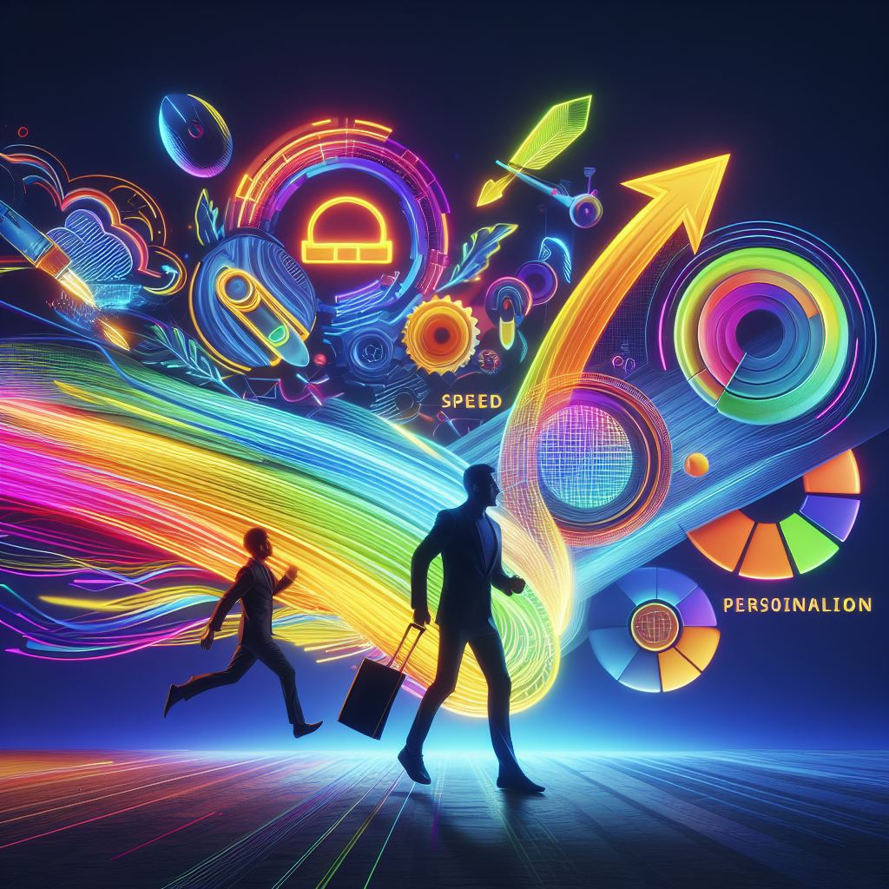
Benefits of the Solution
Faster design process with quick iterations based on customer feedback.
Mass personalization to cater to a broader audience
Enhanced customer satisfaction and brand loyalty.

Slide 8

Key Stakeholders
Prospective Car Buyers
Volkswagen Design Teams
Dealerships
Volkswagen Brand

Slide 9
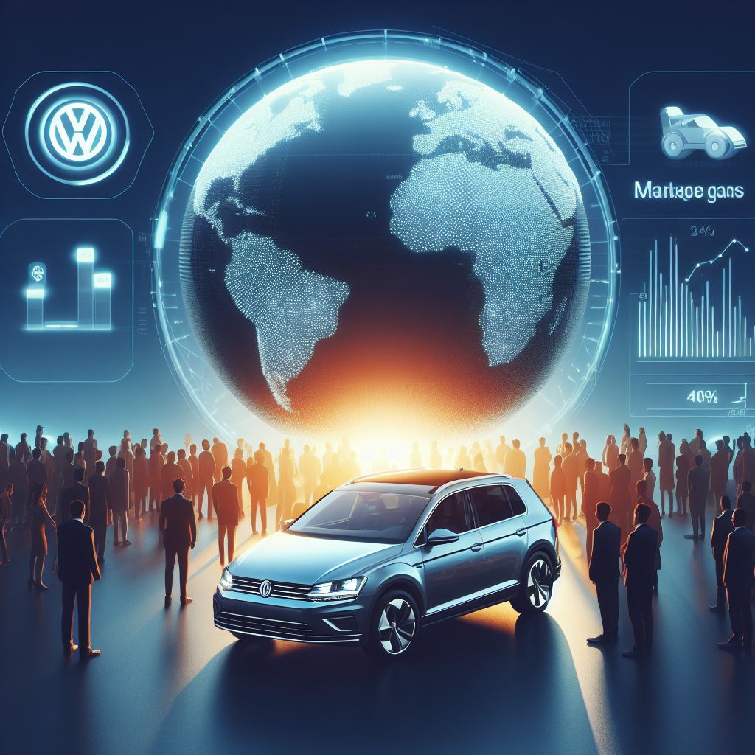
Competitive Advantage
Our innovative solution powered by Generative AI gives Volkswagen a distinct edge in the automotive industry. By offering personalized designs at scale, we not only set a new standard for customization but also position ourselves as pioneers in the field. This translates to a potential surge in market share as customers gravitate towards tailored automotive experiences. Furthermore, our ability to appeal to emerging market segments places us at the forefront of industry trends.

Slide 10
Future Outlook
As we look ahead, the potential for further advancements in AI-driven design within the automotive industry is boundless.
With continued innovation and integration of cutting-edge technologies, Volkswagen is poised to be at the forefront of this transformative wave.
By nurturing our expertise in Generative AI and staying agile in adopting emerging trends, we are well-positioned to lead the industry into a future defined by personalized automotive experiences.

Slide 11
Thank You

